Slide 1





Error Handling
Exception Responses, Exception Handlers, Global Handlers
SoftUni Team
Technical Trainers
Software University
http://softuni.bg

Slide 2
Table of Contents
Error Handling
Exception Responses
Controller-based Exception Handling
@ExceptionHandler
Global Application Exception Handling
@ControllerAdvise
Exception techniques use cases

Slide 3
Questions
sli.do #java-web

Slide 4

Error Handling
Anticipate! Detect! Resolve!

Slide 5


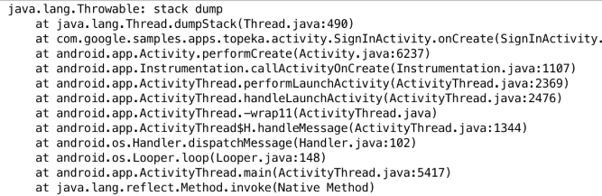

Error Handling
Error handling refers to:
The anticipation, detection and resolution of programming errors
The response & recovery procedures from error conditions
Error handling is necessary!
Improves user experience
Optimizes debugging
Facilitates code maintenance
Ensures product quality
Oops…
We’ve encountered a problem! Don’t worry, we are working on it!

Slide 6
Error Handling
Spring MVC provides several approaches to error handling
Per exception, Per controller, Globally
Depending on the option you are ought to choose
Because each option has its own use cases and circumstances
You can use
Response-annotated custom exceptions
Controller-based handlers on specified actions
@ControllerAdvise annotated classes for global handlers

Slide 7


HTTP Status Codes
Annotated Custom Exceptions

Slide 8
HTTP Status Codes
Unhandled exceptions during a request produce HTTP 500 response
Any custom exception can be annotated with @ResponseStatus
Supports all HTTP status codes
When thrown and unhandled – produces error page with appropriate response
@ResponseStatus(value = HttpStatus.NOT_FOUND, reason = "Product was not found.")
public class ProductNotFoundException extends RuntimeException {
// Exception definition
}

Slide 9
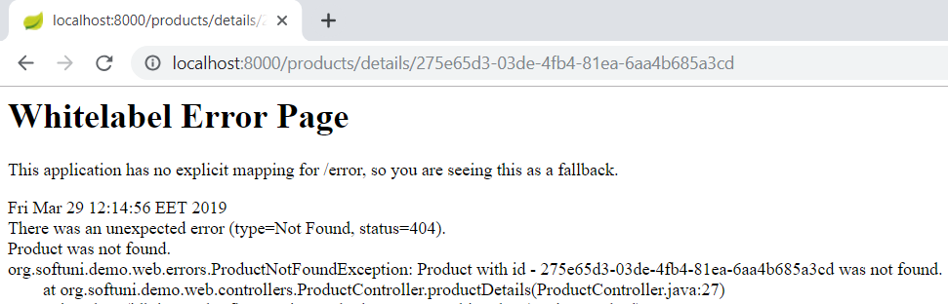
HTTP Status Codes
And the controller action, throwing the exception
@GetMapping("/products/details/{id}")
public ModelAndView productDetails(@PathVariable String id, ModelAndView modelAndView) {
Product product = this.productRepository.findProductById(id);
if(product == null) throw new ProductNotFoundException(id);
modelAndView.addObject("product", product);
return this.view("product/details", modelAndView);
}
The requested URL
The exception’s message
The produced HTTP Status & Message

Slide 10

Controller-Based Error Handling
Exceptions & Views, @ExceptionHandler

Slide 11
Controller-Based Error Handling
You can defined Controller-specific Exception Handlers
Casual non-action methods in a Controller
Annotated with @ExceptionHandler annotation
They work only for the Controller they are defined in
Can be annotated with @ResponseStatus to convert HTTP status
Can accept the caught exception as a parameter
Can return ModelAndView or String (view name)
Can catch multiple exception types

Slide 12
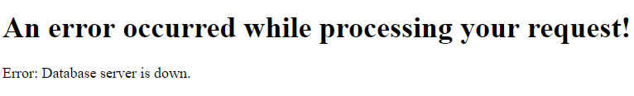
Controller-Based Error Handling
@ExceptionHandler({PersistenceException.class, TransactionException.class})
public ModelAndView handleDbExceptions(DatabaseException e) {
ModelAndView modelAndView = new ModelAndView("error");
modelAndView.addObject("message", e.getMessage());
return modelAndView;
}
Parent Exception
<html>
<head>...</head>
<body>
<h1>An error occurred while processing your request!</h1>
<p th:text="|Error: ${message}|"></p>
</body> </html>

Slide 13
Controller-Based Error Handling
Handler methods have flexible signatures
You can pass in servlet-related objects as parameters
HttpServletRequest, HttpServletResponse
HttpSession, Principal
The Model or ModelAndView cannot be a parameter though
Instead of passing it, you have to setup it inside the method
Nevertheless, this is not an issue because the IoC container would have done the same (pass an empty instance)

Slide 14
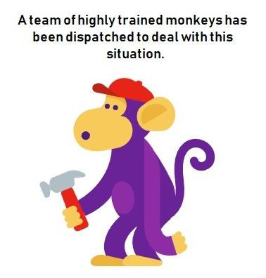
Controller-Based Error Handling
It is not a good practice for full error stacktraces to be exposed
Your users don’t need to see ugly exception web-pages
You may even have security policies which strictly forbid any public exception info
Hide as much information as possible and present User-friendly error pages
For testing purposes you may view details
This may need an environment setup

Slide 15


Global Exception Handling
@ControllerAdvice classes

Slide 16

Global Exception Handling
There is a way to achieve Global exception handling in Spring
This is done through the @ControllerAdvise annotation
Any class annotated with @ControllerAdvise turns into an interceptor-like controller:
Enables global exception handling
Enables model enhancement methods
Enables model-binding customization

Slide 17
Global Exception Handling
In @ControllerAdvice classes you still use @ExceptionHandler
However, this time it refers to the whole application
The error handling is not limited only to a specific controller
@ControllerAdvice
public class GlobalExceptionHandler {
@ExceptionHandler({TransactionException.class, PersistenceException.class})
public ModelAndView handleDatabaseErrors(DatabaseException e) {
ModelAndView modelAndView = new ModelAndView("index");
modelAndView.addObject("message", e.getMessage());
modelAndView.addObject("stack", {...} /* Formatted Stack Trace */);
return modelAndView;
}
}

Slide 18
Global Exception Handling (REST)
RESTful requests may also generate unexpected exceptions
HTTP Error response codes are a good choice
However sometimes you might need more than just a status
Customized Error Object, which can be presented on the Client
Limited Information returned to the Client
You can customize the Error Response by introducing a class
The Error Handler itself remains the same as in casual web apps

Slide 19



Global Exception Handling (REST)
public class ErrorInfo {
public final String url;
public final String ex;
public ErrorInfo(String url, Exception ex) {
this.url = url;
this.ex = ex.getLocalizedMessage();
}
}
@ControllerAdvice
public class GlobalRESTExceptionHandler { @ResponseStatus(HttpStatus.INTERNAL_SERVER_ERROR)
@ExceptionHandler({TransactionException.class, PersistenceException.class})
public @ResponseBody ErrorInfo handleRESTErrors(HttpServletRequest req, DbException e) {
return new ErrorInfo(req.getRequestURL(), ex);
}
}

Slide 20

Exception Handling
Live Demonstration

Slide 21
What to use When?
Spring offers many choices, when it comes to error handling
There are some semantics, that should be followed, though
Here are some rules for good error handling structure:
For custom exceptions, @ResponseStatus is the ideal choice
For all other exceptions, @ExceptionHandler methods in @ControllerAdvice classes should be implemented
For Controller-specific exceptions, @ExceptionHandler methods should be added alongside the actions

Slide 22

Summary
Error Handling is essential
Improves User Experience
Improves Application maintenance
Error Handling in Spring
HTTP Error Response Status Codes
@ExceptionHandler methods
@ControllerAdvice global handlers
When to use What?
Additional Error Handling information here
…
…
…

Slide 23
https://softuni.bg/trainings/courses

Slide 24












SoftUni Diamond Partners

Slide 25




SoftUni Organizational Partners

Slide 26




Trainings @ Software University (SoftUni)
Software University – High-Quality Education and Employment Opportunities
softuni.bg
Software University Foundation
http://softuni.foundation/
Software University @ Facebook
facebook.com/SoftwareUniversity
Software University Forums
forum.softuni.bg

Slide 27

License
This course (slides, examples, demos, videos, homework, etc.) is licensed under the "Creative Commons Attribution-NonCommercial-ShareAlike 4.0 International" license

